Slide 1
The Ecosystem
of
Apple vs Android
The Ecosystem
of
Apple vs Android
By Kaleb

Slide 2
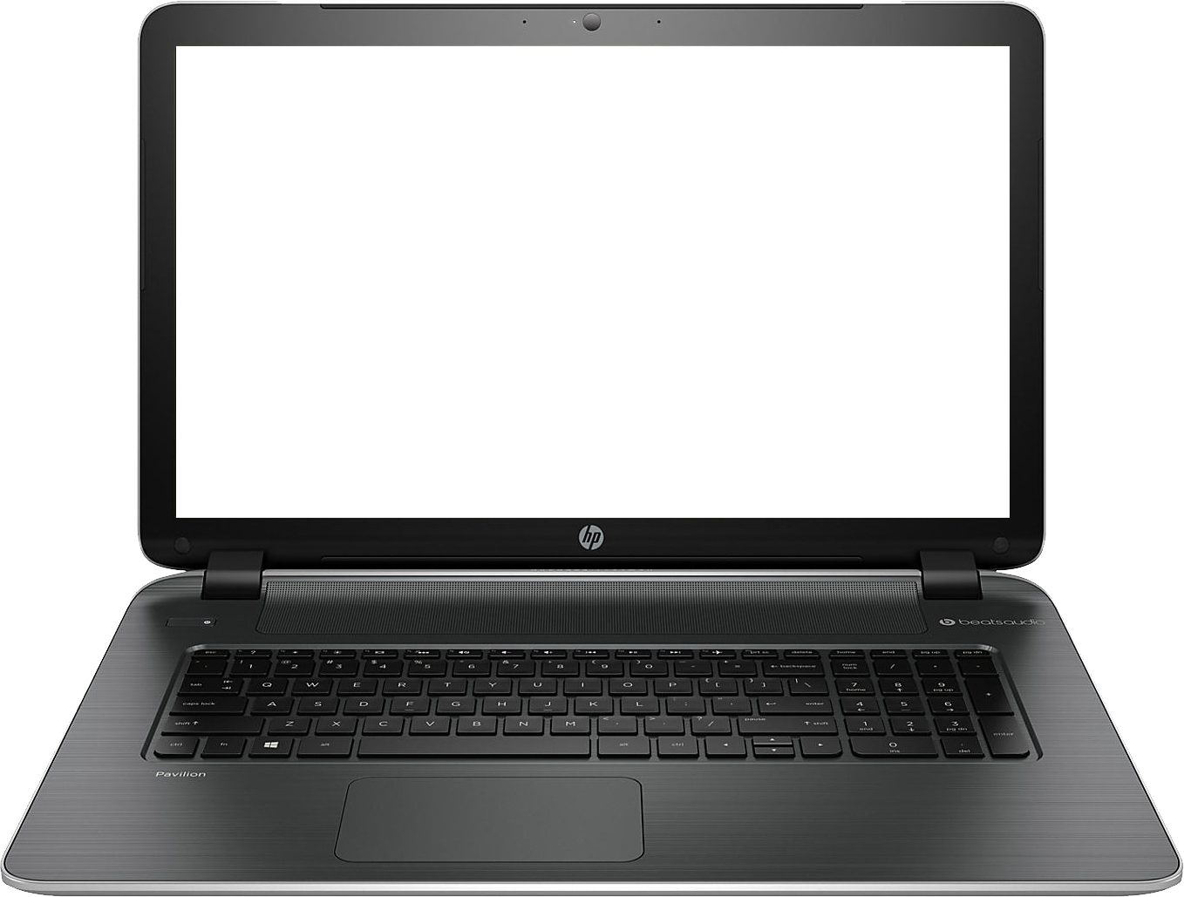
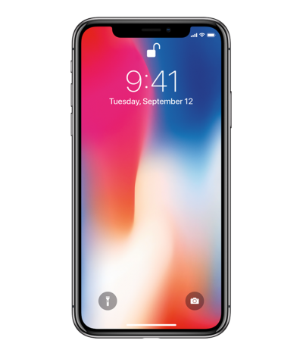
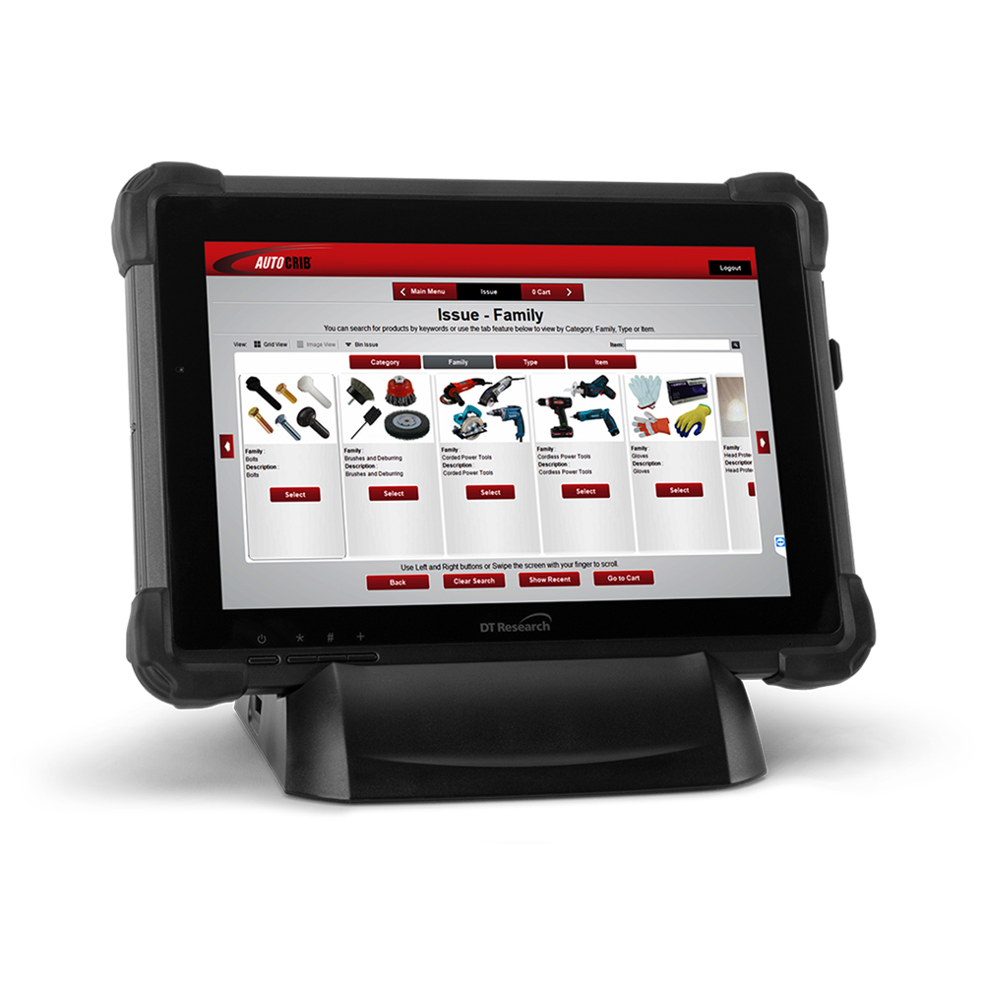

Slide 3
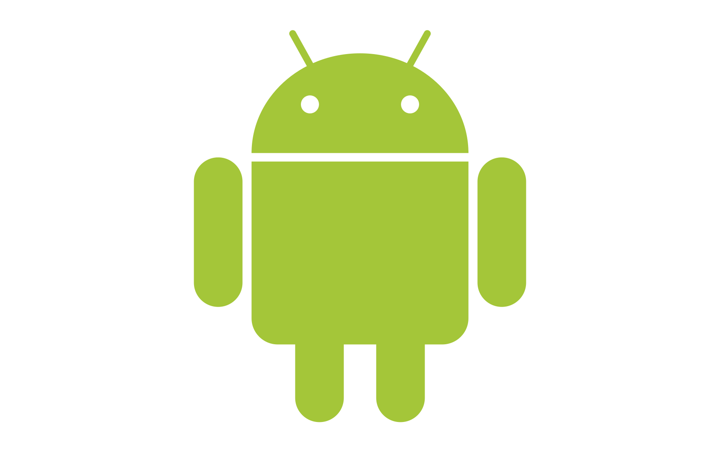


Slide 4
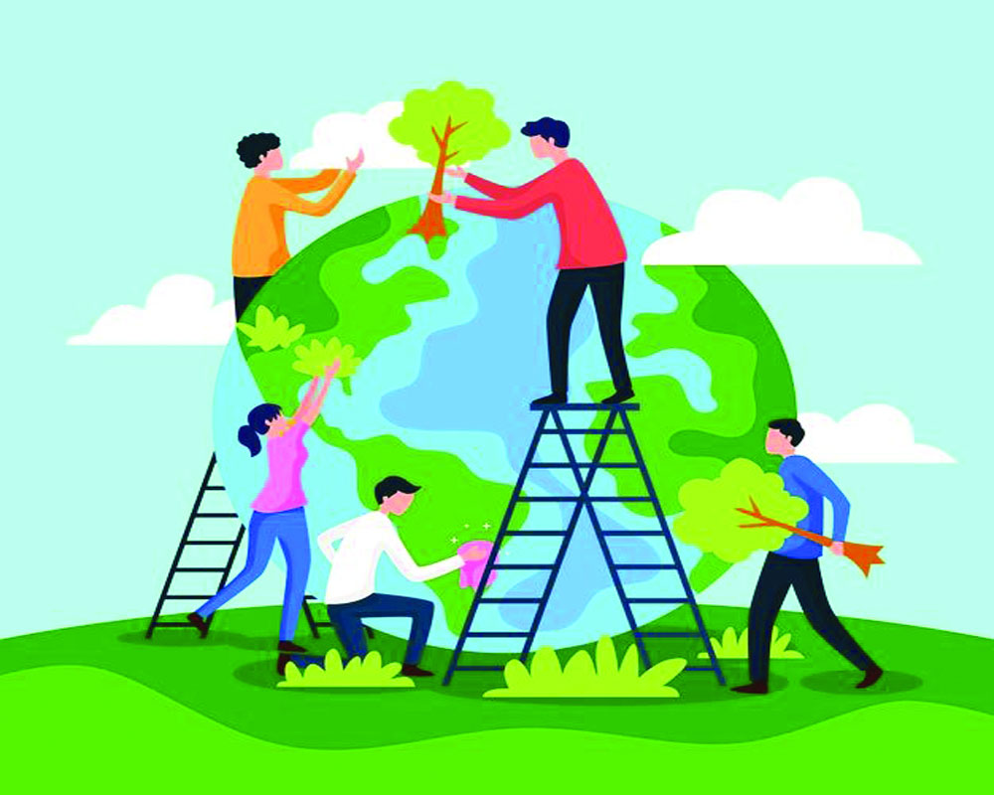
Ecosystem
ec·o·sys·tem
/ˈēkōˌsistəm/
noun

Slide 5




Slide 6
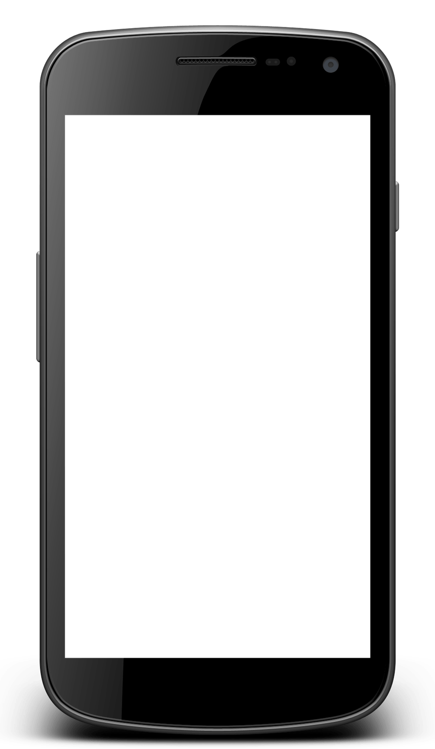
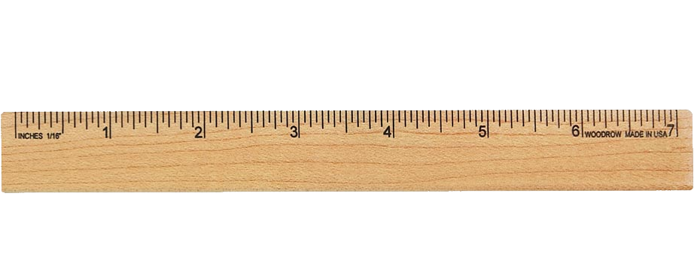

Slide 7


Slide 8
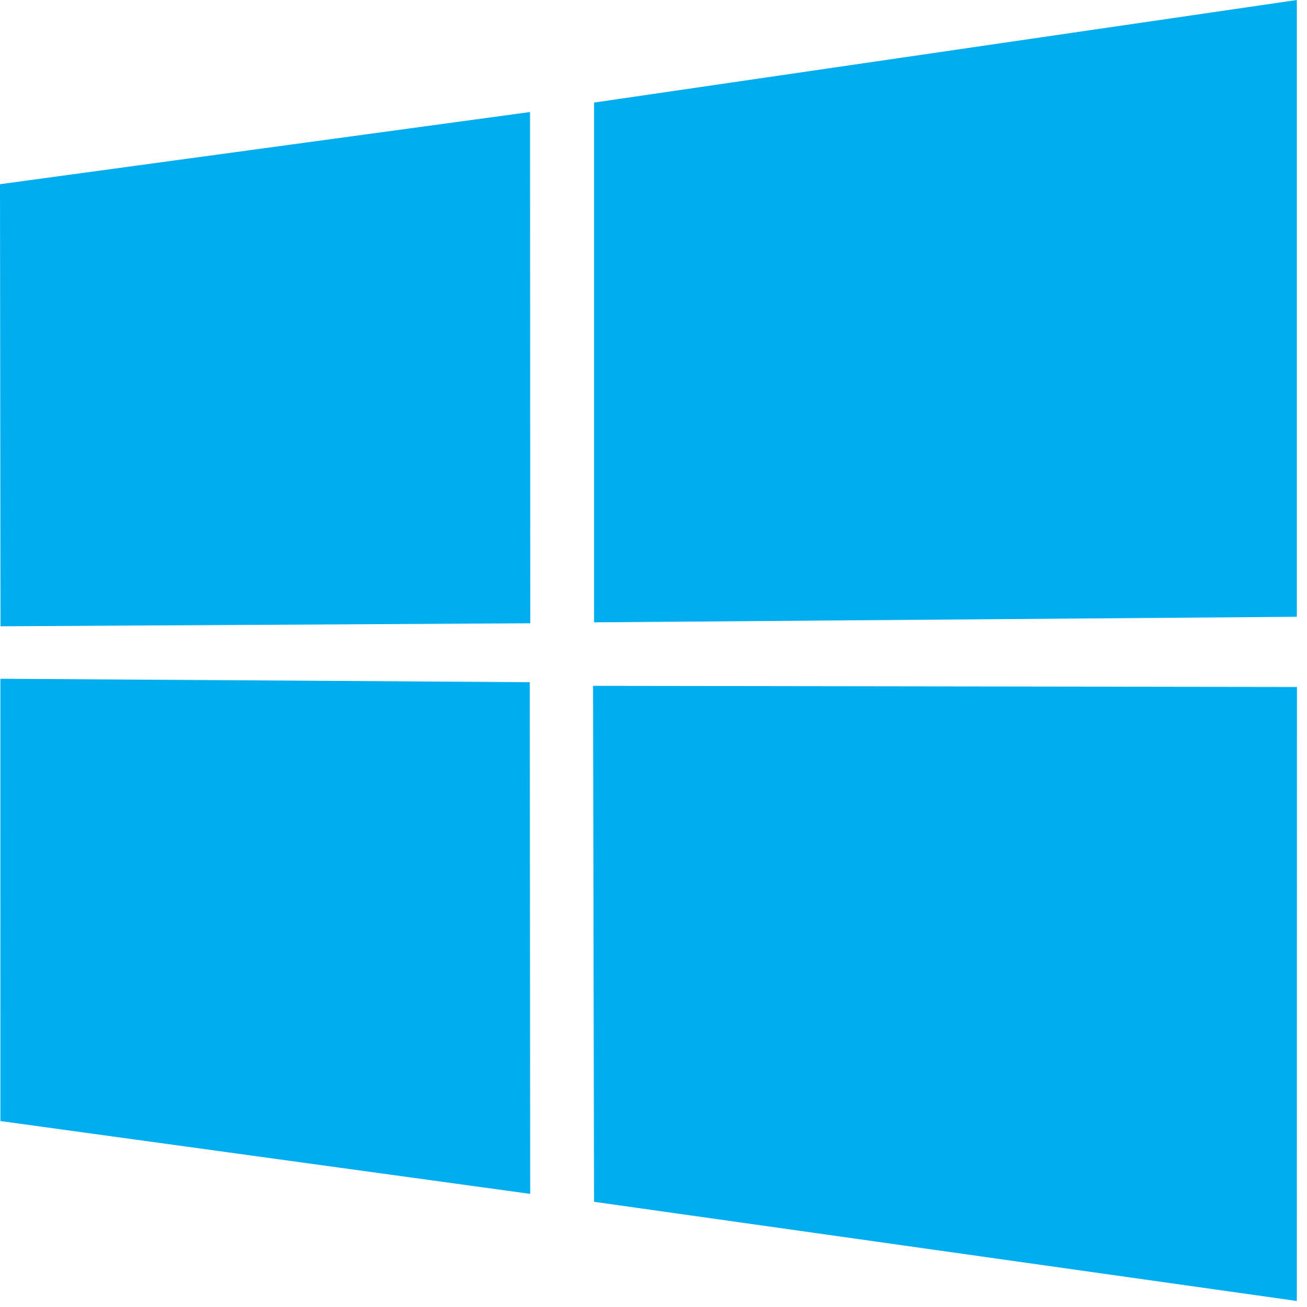


Slide 9


Slide 11


